Slide 1
Weather History
A data warehouse system
Li-Chi Chang

Slide 2
Outline
Introduction
Technology
Database schema
Data
Components
Demo
Discussion and Future work
Conclusion

Slide 3
Introduction
Build a warehouse website
See some summary data
Query data in specific range(like slicing or cubing)
Use existing resources, build a crawler and get data periodically.

Slide 4
Technology
Google AppScript
API timer, daily import data from trustable resource
MongoDB
Database
NoSQL, fit for high throughput web system.
Django
Front/Back end
Python based MVC architecture.
Python
Import data to Database

Slide 5
Database schema
Star schema
Weather Description
Weather description ID
Title
Detail
History
Location ID
Time Year Month Day Hour …
Weather Info Temperature Pressure Humidity …
Weather description ID
Locations
Location ID
Latitude
Longitude

Slide 6
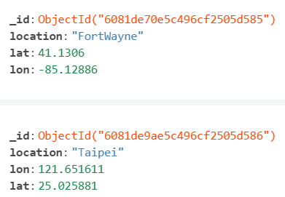
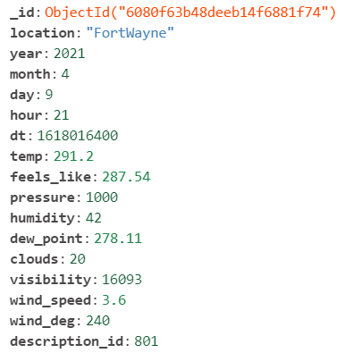
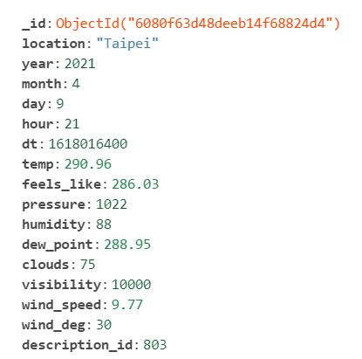
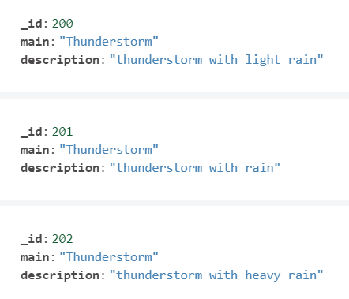
Data
Location data
Weather History data
Weather Description data

Slide 7
Components – Data Processing
Load Data Timer
Programming language: Google AppScript
This timer is responsible for data clawer.
Collect data from Open Weather by APIs every 12 hrs.
The format of downloaded data is JSON.
Json to Database
Programming language: Python
This is a pipelined Python program; one click to import JSON files to Database.
Parse source data and transfer it to fit my data schema.

Slide 8
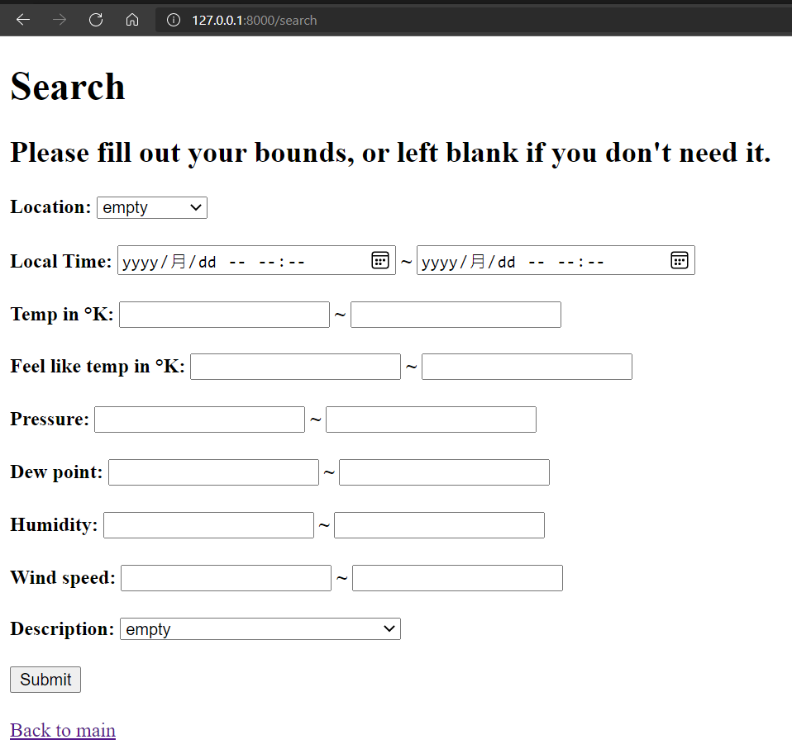
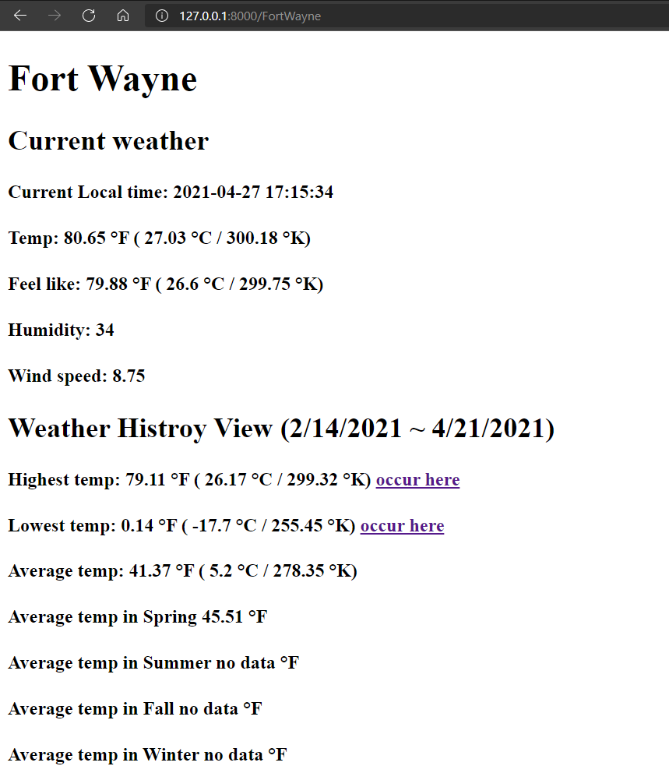
Components – Show and Query Interface
Weather Report Web Server
Programming language: Python, using Django MVC architecture
This web server show current weather, location summary and historical weather.
This web server also support Query API, Query page.

Slide 9
Demo
Use link (unavailable after 2 hours)
Weather Histroy (68de788dc2fa.ngrok.io)
Li-Chi-Chang/weather_report (github.com)

Slide 10
Discussion – Pros and goods
Easy to import new locations.
Only one step: Add Cities information into Locations collection.
Easy to implement new functions.
Can sightly change the front page and add a function at backend to build a new feature.
MVC structure.
Easy to deploy.
MongoDB, Django are cross platform tools.
These tools can be found on Linux and Windows.

Slide 11
Discussion – Cons and limitations
Only have 3 months / 2 locations dataset
Need time to collect
Need to pay for older history records
Show Table or dynamic graph on Django
Not easy to show real time analysis figure on web page.
JSON to DB part still not an automatic process.
If want to automate the process, need a long run server and deploy it as a system service.

Slide 12
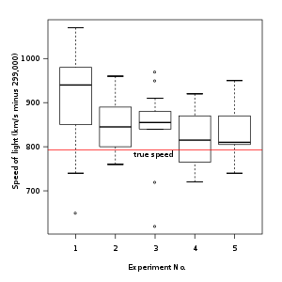
Future work
Show Table or dynamic graph
Use Box plot instead of text description
Add more locations
Automate all the process

Slide 13
Conclusion
MongoDB support vary Query functions. It is easy to build a frontend query APIs and interfaces.
This project has high scalability, can easily add extensions like more locations.
If budget is enough, we can use a long run server to build a total automatic server.

Slide 14
References
Openweathermap api document
Free account quotas Pricing - OpenWeatherMap
5 days historical data One Call API - OpenWeatherMap
Weather condition id code/ icon Weather Conditions - OpenWeatherMap
Google App Script document
Free account quotas Quotas | Apps Script | Google Developers
Code document Overview of Google Apps Script | Google Developers
MongoDB document
Installation MongoDB Community Download | MongoDB
APIs for Python and Node.js The MongoDB 4.4 Manual — MongoDB Manual

